Slide 1


Don’t talk to strangers
Test isolation with containers
Hristo Iliev, Georgi Sabev | SAP Labs
18-19 November, Sofia

Slide 2
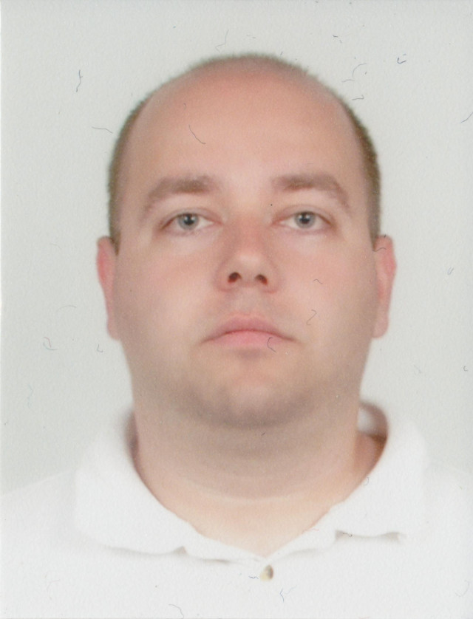
Hristo Iliev
SAP
NetWeaver Java Sever
SAP HANA Cloud Platform
Open Source
Eclipse Virgo
Cloud Foundry (Diego & Abacus)
ISTAcon.org
18-19 November, Sofia
Notes:
In order to build quality software we need:
Tests so that we know it works as expected
Automation that allows us to develop and experiment in a cheap and quick manner -> improve
Tools can help alot
Discipline is required to keep all that is good and improve further

Slide 3
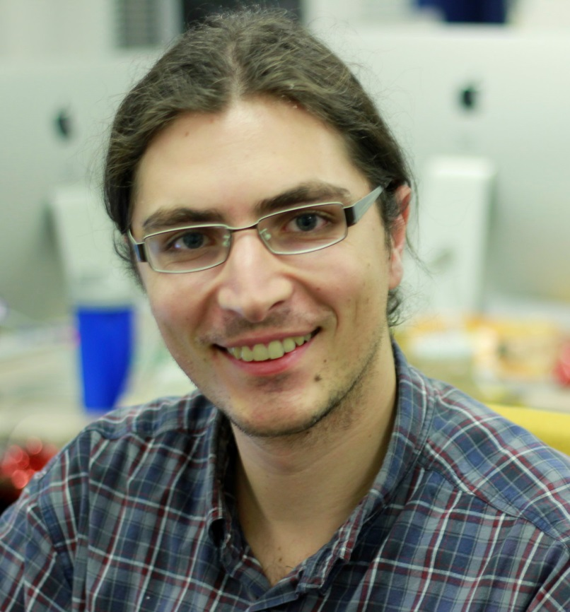
Georgi Sabev
SAP
SAP HANA Cloud Platform
Open Source
Cloud Foundry (Diego & Abacus)
ISTAcon.org
18-19 November, Sofia
Notes:
In order to build quality software we need:
Tests so that we know it works as expected
Automation that allows us to develop and experiment in a cheap and quick manner -> improve
Tools can help alot
Discipline is required to keep all that is good and improve further

Slide 4
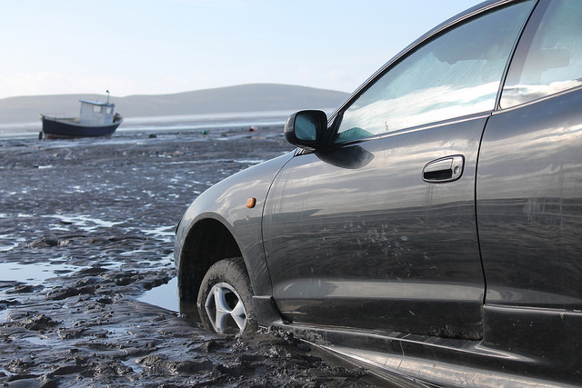
Pictures Creative Commons @ Flickr
ISTAcon.org
18-19 November, Sofia
Notes:
All photos except our own images are Creative Commons license

Slide 5
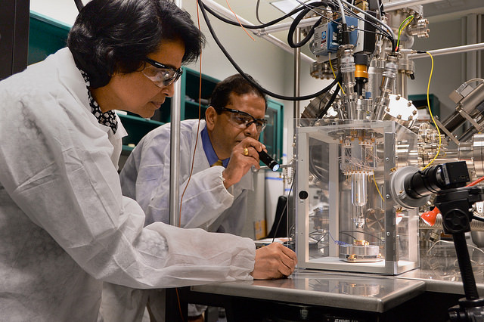
Creating Working Software
Tests
Automation
Discipline
ISTAcon.org
18-19 November, Sofia
Notes:
In order to build quality software we need:
Tests so that we know it works as expected
Automation that allows us to develop and experiment in a cheap and quick manner -> improve
Tools can help a lot
Discipline is required to keep all that is good and improve further

Slide 6
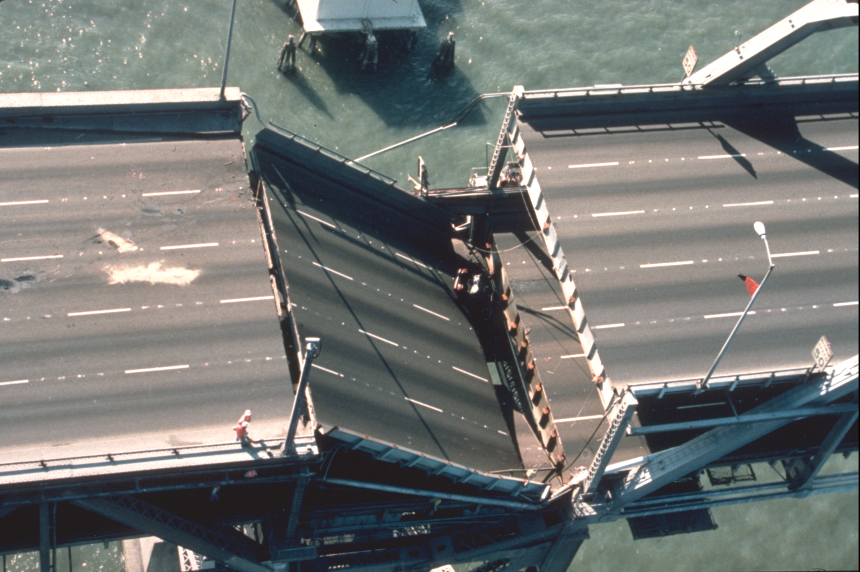
Problems
ISTAcon.org
18-19 November, Sofia
Notes:
Everyone want to build quality systems
Turns out difficult
Following are examples of common pitfalls during testing
We will introduce tools that mitigate the presented problems

Slide 7

Resources left behind
Environment variables
Database records
Files
Programs / libraries
ISTAcon.org
18-19 November, Sofia
Notes:
The first problem we want to present is the test pollution
In general pollution is caused by resources left behind (as in real life).
These can be
env. Variables
database/storage/persistence data causing an app/program to appear in certain state
files (another form of state)
dependencies already present on the machine

Slide 8
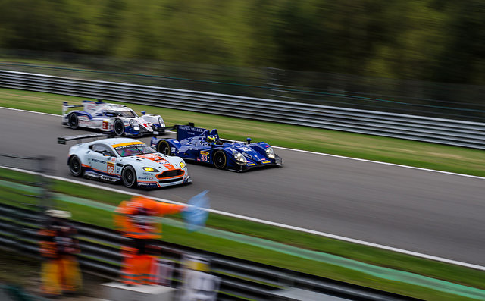
Resource contention
Processes compete for
CPU
Memory
I/O
ISTAcon.org
18-19 November, Sofia
Notes:
Consuming too much cpu/memory causes other leads to starvation for other processes
Running tests on the same machine may lead to delays and failures (hard to debug)
Not talking for performance but for functional - unit/integration tests

Slide 9
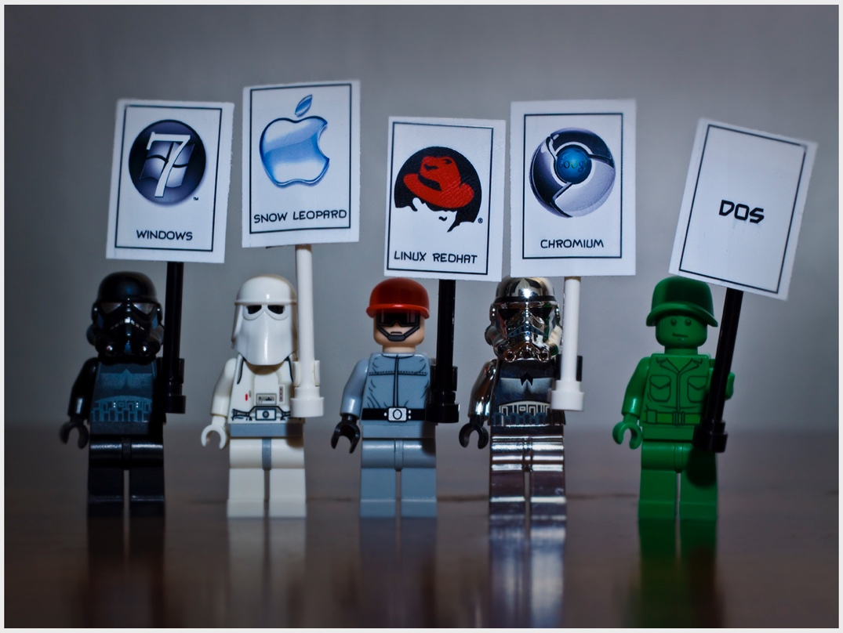
Multiple environments
OS
Mobile / Desktop
Cloud / Standalone
Databases
Versions
ISTAcon.org
18-19 November, Sofia
Notes:
Different
Kind of devices (emulators and physical hardware)
landscapes (cloud)
Backends
Libraries / set of dependencies and programs
Let’s see how we can solve this …

Slide 10
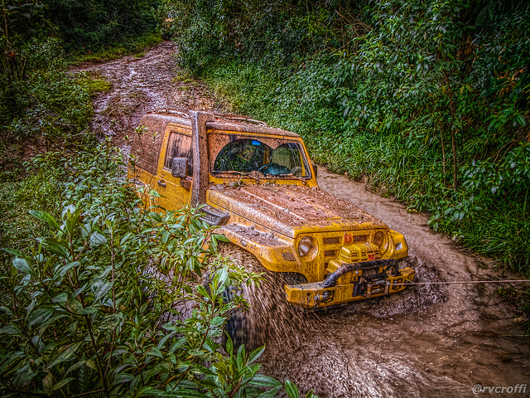
Test problems summary
Test pollution
Resource contention
Multiple environments
ISTAcon.org
18-19 November, Sofia
Notes:
Let’s see how all these problems can be addressed …

Slide 11

Solutions
Traditional
Dedicated hardware
Virtual machines
Cloud: AWS, Azure
New tools
ISTAcon.org
18-19 November, Sofia
Notes:
Dedicated hardware for Android
OS env: AWS (mostly linux), Azure (mostly Windows)
Recently a few tools and technologies became popular. Let’s see how they can help solve our issues…

Slide 12
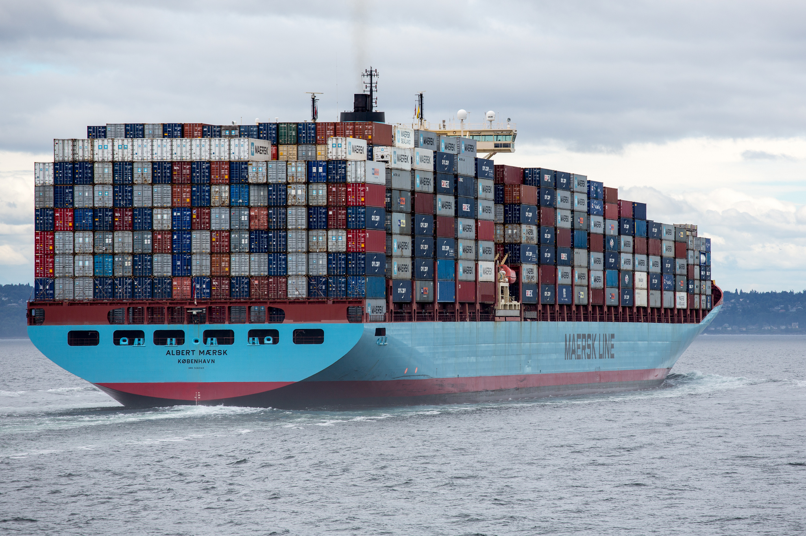
Containers build, isolate, ship
ISTAcon.org
18-19 November, Sofia

Slide 13
Container: Resource isolation
Shared resources
Kernel
Process A
Process E
Process B
Process C
Process D
Process F
Tenant 1
Tenant 2
Tenant 3
ISTAcon.org
18-19 November, Sofia

Slide 14
Container: Resource isolation
A
B
C
D
E
F
Kernel
Process A
Process E
Process B
Process C
Process D
Process F
Tenant 1
Tenant 2
Tenant 3
ISTAcon.org
18-19 November, Sofia

Slide 15
Container: Resource isolation
CPU
A
B
C
D
E
F
Kernel
Process A
Process E
Process B
Process C
Process D
Process F
Tenant 1
Tenant 2
Tenant 3
ISTAcon.org
18-19 November, Sofia

Slide 16
Container: Resource isolation
CPU
A
B
C
D
E
F
Kernel
Linux Kernel
Process A
Process E
Process B
Process C
Process D
Process F
Tenant 1
Tenant 2
Tenant 3
ISTAcon.org
18-19 November, Sofia

Slide 17
Container: Namespace isolation
Process ID
A
B
C
D
E
F
Kernel
Process A
Process E
Process B
Process C
Process D
Process F
Tenant 1
Tenant 2
Tenant 3
ISTAcon.org
18-19 November, Sofia

Slide 18
Container: Namespace isolation
Process ID
A
B
C
D
E
F
Kernel
Process A
Process E
Process B
Process C
Process D
Process F
Tenant 1
Tenant 2
Tenant 3
ISTAcon.org
18-19 November, Sofia

Slide 19
Container: Namespace isolation
Process ID
A
B
C
A
A
B
Kernel
Same PID
Process A
Process A
Process B
Process C
Process A
Process B
Tenant 1
Tenant 2
Tenant 3
ISTAcon.org
18-19 November, Sofia

Slide 20
Container: Namespace isolation
PID, Network, Mount, User
Kernel
Process A
Process B
Process C
Process A
Process A
Process B
Tenant 1
Tenant 2
Tenant 3
ISTAcon.org
18-19 November, Sofia

Slide 21
Containerization = Lightweight Virtualization
Virtual Machine
Virtual Machine
App
App
App
App
Container
Container
App
App
App
App
Bins / libs
Bins / libs
Operating System
Operating System
Bins / libs
Bins / libs
Hypervisor
Operating System
Hardware
Hardware
Virtualization
Containerization
ISTAcon.org
18-19 November, Sofia
Notes:
Virtualization emulates all devices (memory, disk, video, ….). We can run different OS-es
Containerization allows us to run only a single OS, but is much cheaper and lightweight.

Slide 22
Container
?
ISTAcon.org
18-19 November, Sofia

Slide 23

Container
Network
PID
?
=
cgroups
User
Isolation
ISTAcon.org
18-19 November, Sofia

Slide 24
Container
Network
PID
?
=
+
cgroups
User
Isolation
Content
ISTAcon.org
18-19 November, Sofia

Slide 25
Container
Network
PID
?
=
+
+
cgroups
User
Isolation
Content
Processes
ISTAcon.org
18-19 November, Sofia

Slide 26
Container
Network
PID
cgroups
User
ISTAcon.org
18-19 November, Sofia

Slide 27
Container actions
Make me a container
Put this in it
Run this for me
ISTAcon.org
18-19 November, Sofia

Slide 28
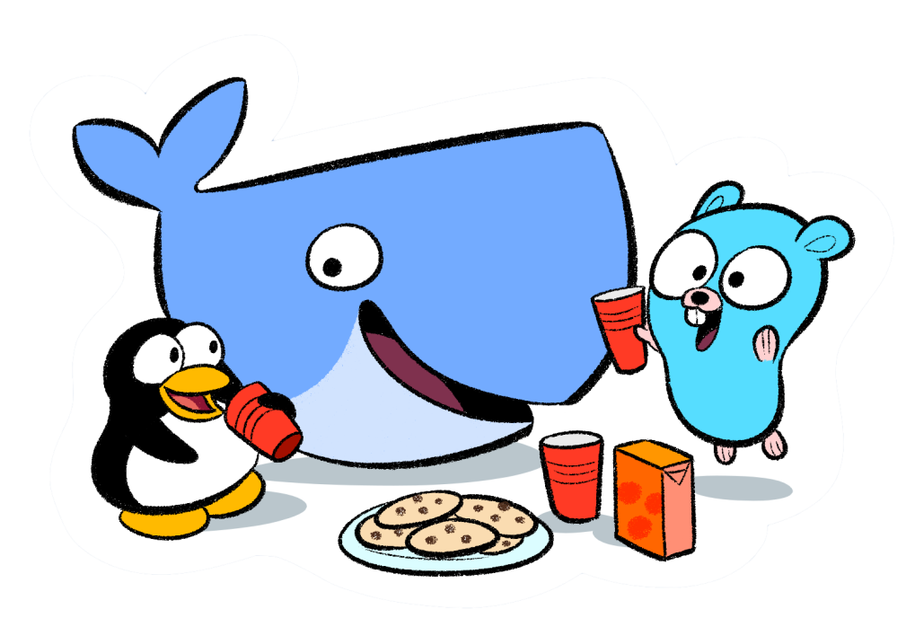
Docker
“Build, Ship, Run” Containers
Dockerfile
Docker image
Docker Hub
ISTAcon.org
18-19 November, Sofia
Notes:
Docker is an implementation of the container idea
Provides definition of container in “Dockerfile”
The container is stored as image
The image is stored on a site/repo - Hub

Slide 29
Dockerfile
Make me a container
Put this in it
Run this for me
ISTAcon.org
18-19 November, Sofia

Slide 30
Dockerfile
Example:
FROM debian:stable
RUN apt-get update && apt-get install -y --force-yes apache2
EXPOSE 80 443
VOLUME ["/var/www", "/var/log/apache2", "/etc/apache2"]
ENTRYPOINT ["/usr/sbin/apache2ctl", "-D", "FOREGROUND"]
ISTAcon.org
18-19 November, Sofia

Slide 31
Dockerfile
Example:
FROM debian:stable
RUN apt-get update && apt-get install -y --force-yes apache2
EXPOSE 80 443
VOLUME ["/var/www", "/var/log/apache2", "/etc/apache2"]
ENTRYPOINT ["/usr/sbin/apache2ctl", "-D", "FOREGROUND"]
ISTAcon.org
18-19 November, Sofia

Slide 32
Dockerfile
Example:
FROM debian:stable
RUN apt-get update && apt-get install -y --force-yes apache2
EXPOSE 80 443
VOLUME ["/var/www", "/var/log/apache2", "/etc/apache2"]
ENTRYPOINT ["/usr/sbin/apache2ctl", "-D", "FOREGROUND"]
ISTAcon.org
18-19 November, Sofia

Slide 33
Dockerfile
Example:
FROM debian:stable
RUN apt-get update && apt-get install -y --force-yes apache2
EXPOSE 80 443
VOLUME ["/var/www", "/var/log/apache2", "/etc/apache2"]
ENTRYPOINT ["/usr/sbin/apache2ctl", "-D", "FOREGROUND"]
ISTAcon.org
18-19 November, Sofia

Slide 34


https://github.com/hsiliev/strangers
ISTAcon.org
18-19 November, Sofia
Notes:
Now it’s a time for demo.
You can find the source, container definition (dockerfile) and the presentation itself in github
You can take a picture so you don’t have to remember or write down the address.

Slide 35
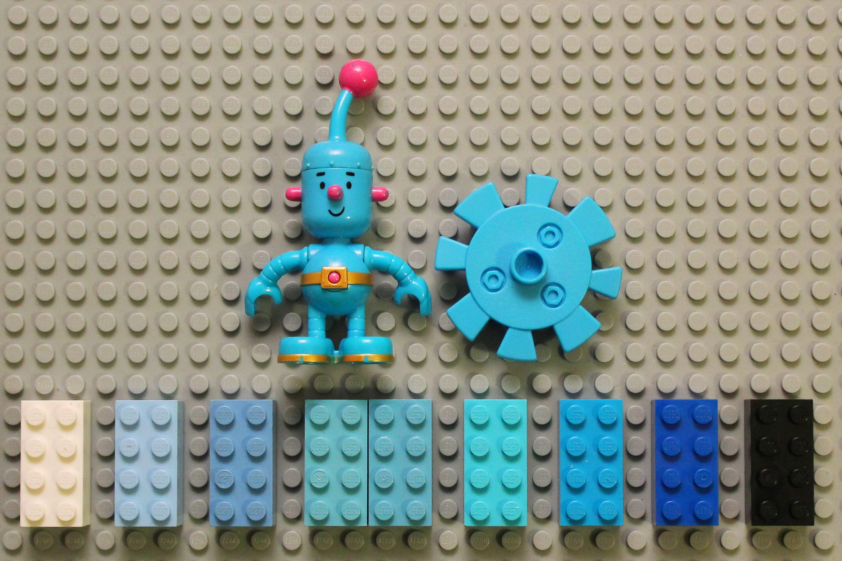
Demo
ISTAcon.org
18-19 November, Sofia
Notes:
Run 2 (or more) mvn clean install in parallel to demonstrate they fail
Now start a container with Ubuntu to show that containers actually work and show
uname
Whoami
restart does not work –this is not a VM
Run 2 containers to show that mvn clean install now works

Slide 36
Containers: Pros & Cons
Pros
Isolation
Reproducible environment
Easy to maintain
Cons
Multi-platform
Discipline
ISTAcon.org
18-19 November, Sofia
Notes:
Linux only. Windows requires different VM
Discipline – cleanup still needed. CPU and memory contention is problem in containers too. This has to be addressed in the same way as with VM/standalone env.

Slide 37
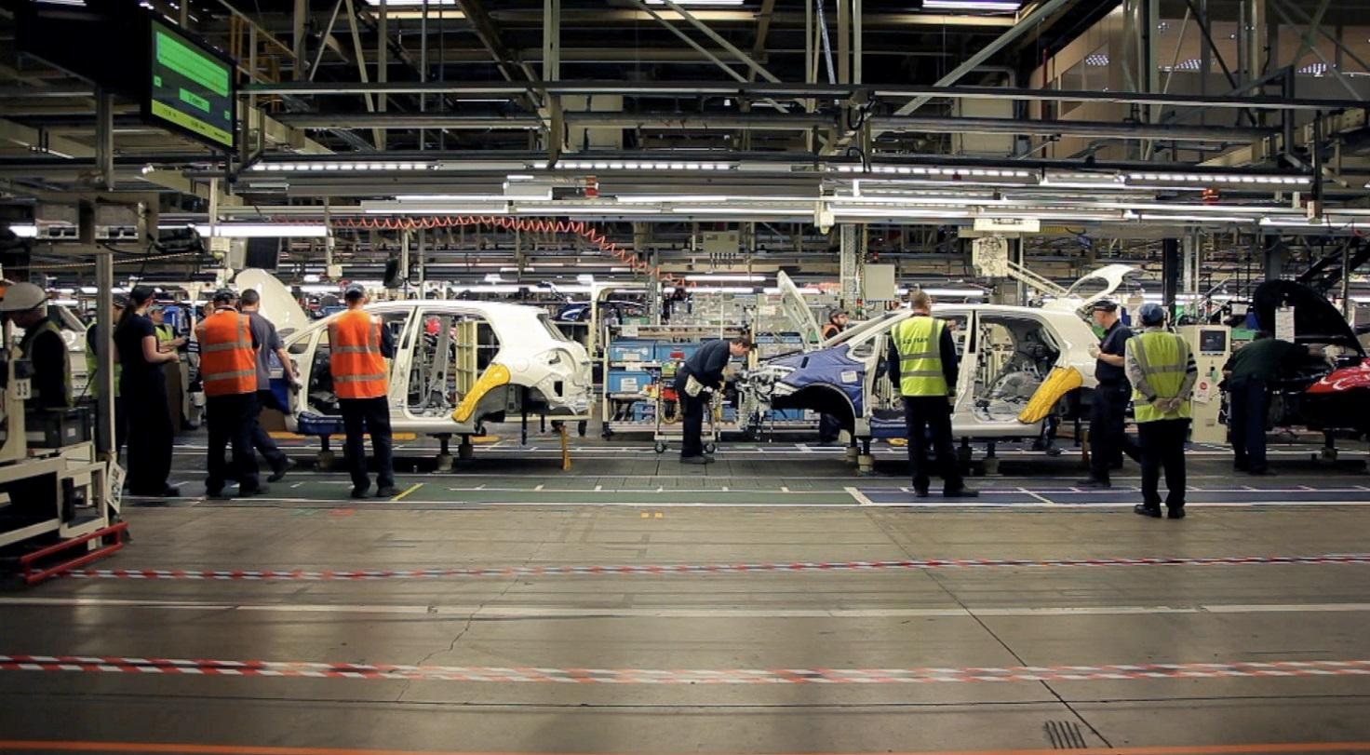
Software Production
Complexity
Tests
Automation
ISTAcon.org
18-19 November, Sofia
Notes:
When producing softwere we have to:
Deal with high complexity
Have an ‘assembly line’ like process for testing
Have this automated
We can do everyting in a container, however we are missing one important concept …

Slide 38

Pipelines Multiple-builds
ISTAcon.org
18-19 November, Sofia
Notes:
Pipelines can help us reach from build through testing to the final packaging and release of our product

Slide 39
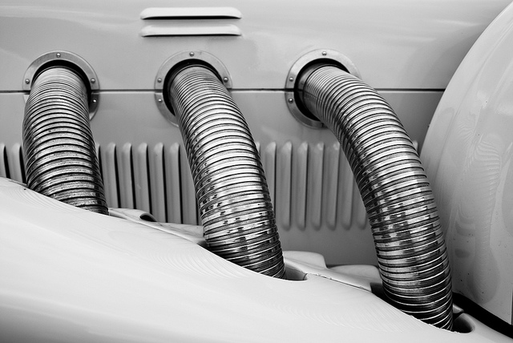
Continuous Integration & Delivery
Multiple
Environments
Products
Teams
Final release
ISTAcon.org
18-19 November, Sofia
Notes:
We need to use different environments
Different product often share a common source base
A lot of teams collaborate on a product
Finally we build and ship a release as a result of all the tests/builds

Slide 40
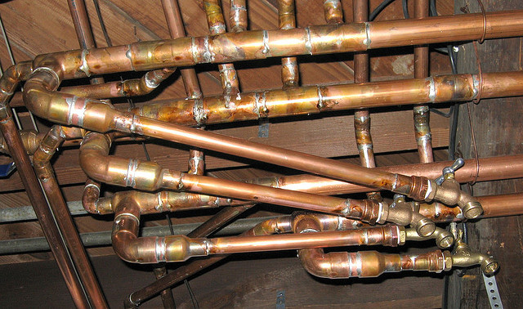
Popular solutions
Build servers
Jenkins
Travis
…
Homegrown
ISTAcon.org
18-19 November, Sofia
Notes:
We can use popular solutions with containers
Or use homegrown tools
However … they all miss the concept of a pipeline and don’t treat it as a first class citizen
That’s why ...

Slide 41
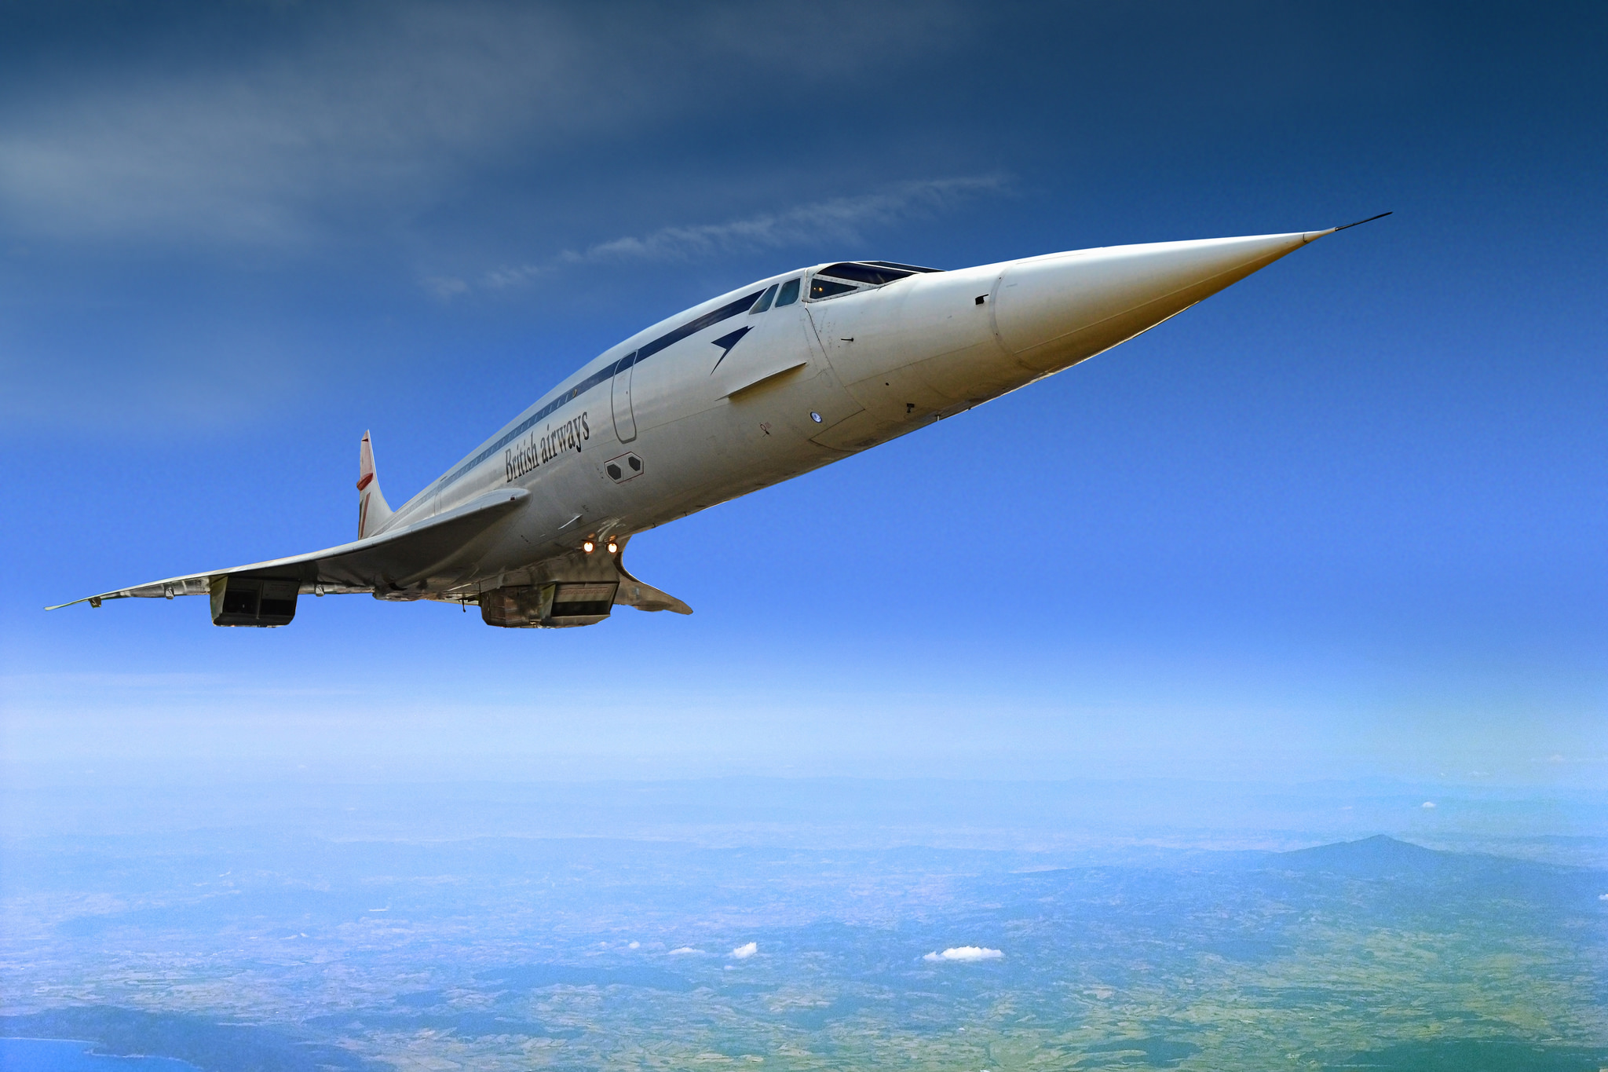
Concourse CI, Pipelines, Delivery
ISTAcon.org
18-19 November, Sofia
Notes:
CI that understands pipelines

Slide 42
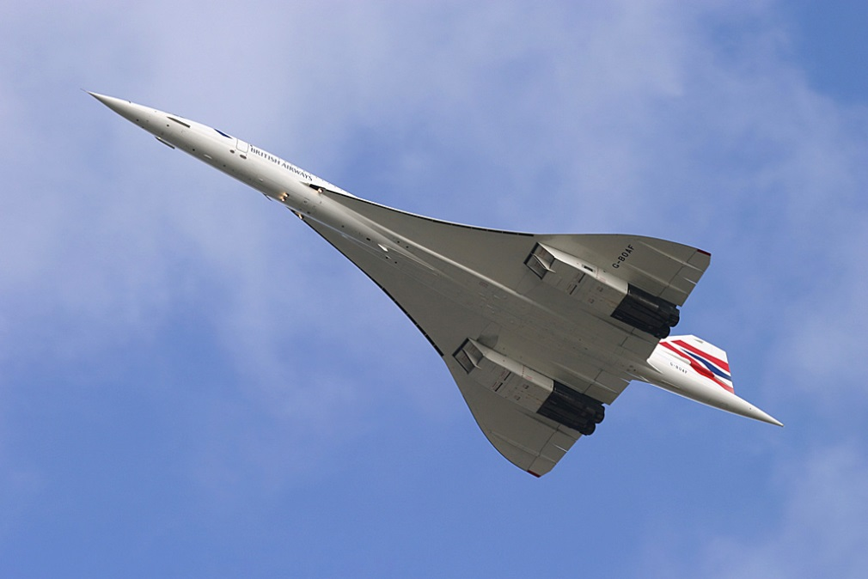
Concourse
CI
Original name: “Concorde”
Reproducible builds
Simple building blocks
Docker containers
ISTAcon.org
18-19 November, Sofia

Slide 43
Concourse: Concepts
Resources
Tasks
Jobs
Build Job
Configure
Make
Install
Source
Binary
ISTAcon.org
18-19 November, Sofia

Slide 44
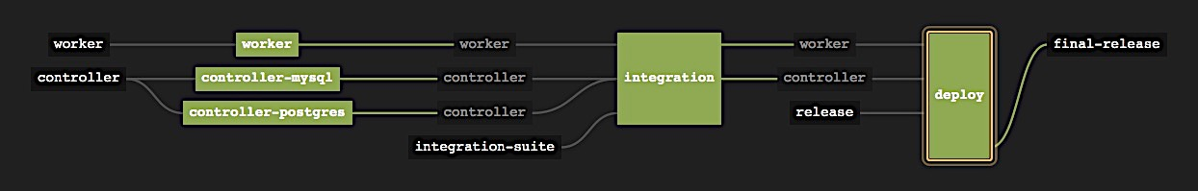
Concourse: Pipeline
validated resource
job
resource
ISTAcon.org
18-19 November, Sofia
Notes:
Conveyor that accepts resources on the input and after processing/manifacturing outputs releases on the output.
Resources:
Worker
Controller
Integration suite
Release
Final-release
Jobs:
Worker build & unit test
Controller build & mysql test
Controller build & postgres test
Integration test
Deploy

Slide 45
Concourse: Pipeline YML
resources:
- name: source
type: git
source:
uri: source.git
branch: master
jobs:
- name: build
plan:
- get: source
- task: build
file: build.yml
ISTAcon.org
18-19 November, Sofia

Slide 46
https://github.com/hsiliev/strangers
ISTAcon.org
18-19 November, Sofia
Notes:
Now it’s a time for demo.
You can find the source, container definition (dockerfile) and the presentation itself in github
You can take a picture so you don’t have to remember or write down the address.

Slide 47
Demo
ISTAcon.org
18-19 November, Sofia
Notes:
Show our local concourse pipeline and explain what it does
Change the source of the example and demonstrate:
Concourse picks the change
Runs tests in parallel (in containers)
Packages and releases the code

Slide 48
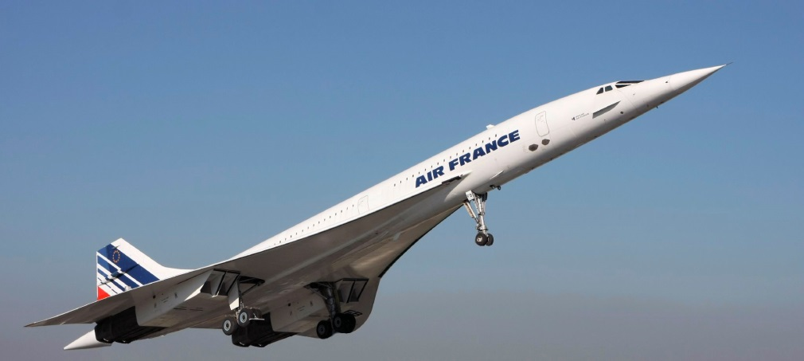
Concourse: Pros & Cons
Pros
Reproducible environment
Native pipeline support
Release process modeling
Cons
Maturity
Pipeline management
Scripting
ISTAcon.org
18-19 November, Sofia
Notes:
Pros
Reproducible environment – configuration in pipeline.yml
Native pipeline support – pipeline = resources + tasks & jobs
Release process modeling – easy to model the whole (end to end) release process
Cons
Maturity – not matury. A lot of changes
Pipeline management – build & support of pipelines is hard
Scripting – a lot of scripting involved in tasks/jobs

Slide 49

Integer tincidunt libero a ex venenatis cursus. Vivamus accumsan congue tristique.
Up to
Six bullets
For best results
Up to
Six bullets
For best results
ISTAcon.org
18-19 November, Sofia

Slide 50

Integer tincidunt libero a ex venenatis cursus. Vivamus accumsan congue tristique.
Up to
Six bullets
For best results
Up to
Six bullets
For best results
ISTAcon.org
18-19 November, Sofia

Slide 51
Major point without a picture
And its subtitle
ISTAcon.org
18-19 November, Sofia

Slide 52
Integer tincidunt libero a ex venenatis cursus. Vivamus accumsan congue tristique.
Up to
Six bullets
For best results
Up to
Six bullets
For best results
ISTAcon.org
18-19 November, Sofia

Slide 53
Integer tincidunt libero a ex venenatis cursus. Vivamus accumsan congue tristique.
Up to
Six bullets
For best results
Up to
Six bullets
For best results
ISTAcon.org
18-19 November, Sofia

Slide 54
Integer tincidunt libero a ex venenatis cursus. Vivamus accumsan congue tristique.
ISTAcon.org
18-19 November, Sofia

Slide 55
Integer tincidunt libero a ex venenatis cursus. Vivamus accumsan congue tristique.
ISTAcon.org
18-19 November, Sofia

Slide 56











Some icons for use throughout the presentation
ISTAcon.org
18-19 November, Sofia

Slide 57

Thank you!
hristo.iliev@sap.com
georgi.sabev@sap.com
Hristo Iliev, Georgi Sabev | SAP Labs
18-19 November, Sofia

